Slide 1
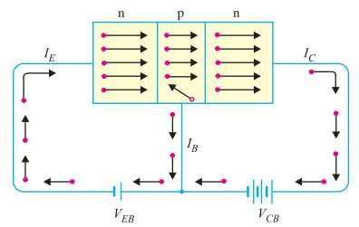
Transistor Operation
Working of npn transistor:
Forward bias Is applied to emitter- base junction and
reverse bias is applied to collector- base junction.
The forward bias in the emitter-base junction causes electrons to move toward base. This constitute emitter current, IE.

Slide 2

Transistor Operation
1) Working of npn transistor:
As this electrons flow toward p-type base, they try to recombine with holes. As base is lightly doped only few electrons recombine with holes within the base.
These recombined electrons constitute small base current.
The remainder electrons crosses base and constitute collector current.

Slide 3
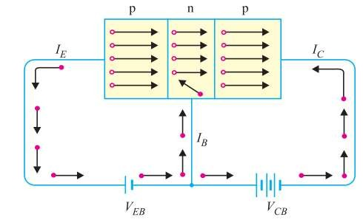
Transistor Operation
Working of pnp transistor:
Forward bias is applied to emitter- base junction and
reverse bias is applied to collector- base junction.
The forward bias in the emitter-base junction causes holes to move toward base. This constitute emitter current, IE

Slide 4
Transistor Operation
2) Working of pnp transistor:
As this holes flow toward n-type base, they try to recombine with electrons. As base is lightly doped only few holes recombine with electrons within the base.
These recombined holes constitute small base current.
The remainder holes crosses base and constitute collector current.

Slide 5
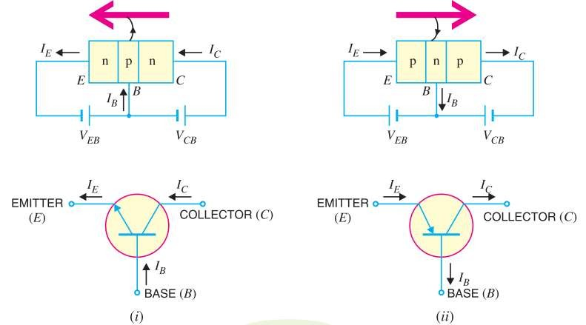
Transistor Symbol

Slide 6
Transistor Operating Modes
Active Mode
Base- Emitter junction is forward and Base- Collector junction is reverse biased.
Saturation Mode
Base- Emitter junction is forward and Base- Collector junction is forward biased.
Cut-off Mode
Both junctions are reverse biased.

